Slide 1
Async/Await Syntax
Concurrency in Node.js vs Python Asyncio
a workshop with
Tahir Ramzan
Android Students Club Facilitator 2015
Google Summer of Coder for CiviCRM in 2015
Google Summer of Coder for ModSec in 2016
Google Code-in Mentor for PostgreSQL in 2018

Slide 2
Bonus at the end, don’t forget ☺

Slide 3
Learning Objectives and Outcomes

Slide 4
Learning Objectives and Outcomes
Understanding of concurrency, parallelism, multi-processing, multi-threading, synchronous and asynchronous execution

Slide 5
Learning Objectives and Outcomes
Understanding of concurrency, parallelism, multi-processing, multi-threading, synchronous and asynchronous execution
Node.js callback functions, promises and async/await syntax

Slide 6
Learning Objectives and Outcomes
Understanding of concurrency, parallelism, multi-processing, multi-threading, synchronous and asynchronous execution
Node.js callback functions, promises and async/await syntax
Python asyncio async/await syntax and Python tasks, coroutines, awaitables and futures

Slide 7
Concurrency

Slide 8
Concurrency
Think about eating and singing simultaneously

Slide 9
Concurrency
Think about eating and singing simultaneously
Single core processor

Slide 10
Concurrency
Think about eating and singing simultaneously
Single core processor
Concurrency in very simple terms means that two or more processes (or threads) run together, but not at the same time. Only one process executes at once.

Slide 11
Parallelism

Slide 12
Parallelism
Think about cooking and singing simultaneously

Slide 13
Parallelism
Think about cooking and singing simultaneously
Multi core processor

Slide 14
Parallelism
Think about cooking and singing simultaneously
Multi core processor
Parallelism on the other hand means that the processes (or threads) run in parallel; meaning they start at the same time and execute alongside each other at the same time.

Slide 15
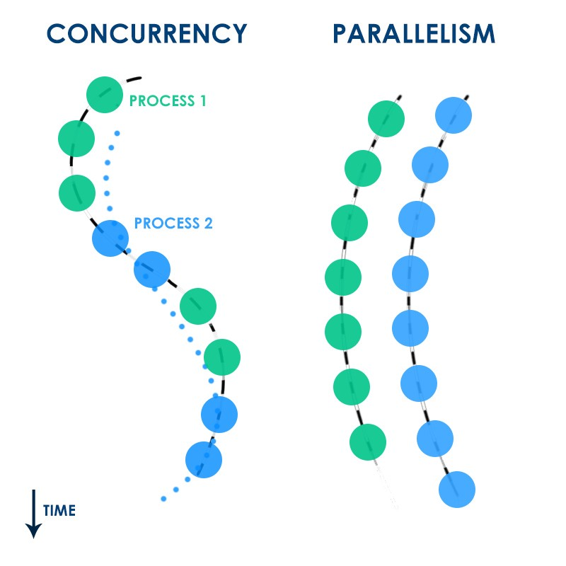

Slide 16
Multi-threading
Think about concurrency

Slide 17
Multi-threading
Think about concurrency
Multithreading is concurrency

Slide 18
Multi-threading
Think about concurrency
Multithreading is concurrency
Single core processor

Slide 19
Multi-threading
Think about concurrency
Multithreading is concurrency
Single core processor
Multithreading is for hiding latency

Slide 20
Multi-threading
Think about concurrency
Multithreading is concurrency
Single core processor
Multithreading is for hiding latency
Multithreading is best for IO

Slide 21
Multi-processing
Think about parallelism

Slide 22
Multi-processing
Think about parallelism
Multiprocessing is parallelism

Slide 23
Multi-processing
Think about parallelism
Multiprocessing is parallelism
Multi core processor

Slide 24
Multi-processing
Think about parallelism
Multiprocessing is parallelism
Multi core processor
Multiprocessing is for increasing speed

Slide 25
Multi-processing
Think about parallelism
Multiprocessing is parallelism
Multi core processor
Multiprocessing is for increasing speed
Multiprocessing is best for computations

Slide 26
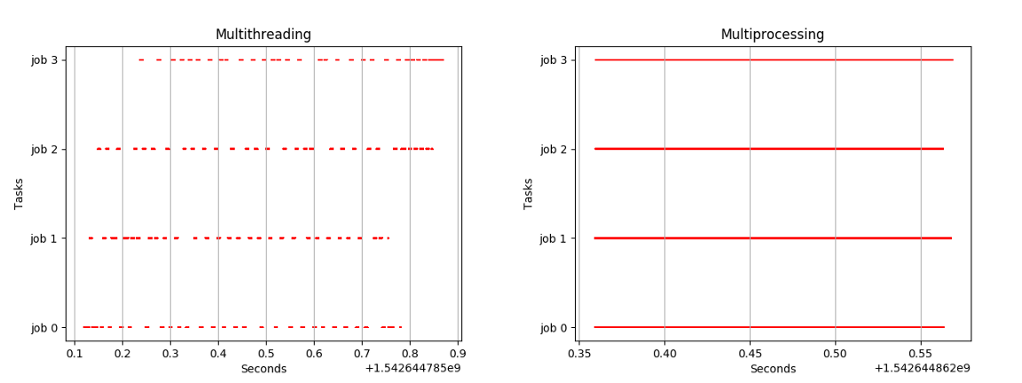

Slide 27
JavaScript and Node.js
Asynchronous
Non-blocking I/O*

Slide 28
JavaScript Callbacks in Node.js
Examples

Slide 29
JavaScript Promises in Node.js
Examples

Slide 30
JavaScript async/await in Node.js
Examples

Slide 31
Asyncio async/await in Python
Examples

Slide 32
References
https://docs.python.org/3/library/asyncio.html
https://docs.python.org/3/library/asyncio-stream.html
https://docs.python.org/3/library/asyncio-task.html
https://docs.python.org/3/library/asyncio-future.html
https://medium.com/contentsquare-engineering-blog/multithreading-vs-multiprocessing-in-python-ece023ad55a
https://medium.com/swift-india/concurrency-parallelism-threads-processes-async-and-sync-related-39fd951bc61d
https://medium.com/@yutafujii_59175/multi-thread-and-multi-process-5559ea5b19ba
https://www.geeksforgeeks.org/difference-between-multitasking-multithreading-and-multiprocessing/
https://www.geeksforgeeks.org/difference-between-multiprocessing-and-multithreading/
https://tylermcginnis.com/async-javascript-from-callbacks-to-promises-to-async-await/
https://medium.com/front-end-weekly/callbacks-promises-and-async-await-ad4756e01d90
https://medium.com/platformer-blog/node-js-concurrency-with-async-await-and-promises-b4c4ae8f4510

Slide 33
Questions and Answers
Contact Details:
+92-312-5518018
tahirramzan@alumni.vu.edu.pk
https://github.com/tahirramzan
https://www.linkedin.com/in/tahirramzan/
https://web.facebook.com/tahirRamzanOne

Slide 34
BONUS ☺
Support open source and earn a limited-edition T-shirt!
Hacktoberfest is open to everyone in our global community!
Pull requests can be made in any GitHub-hosted repositories
Sign up anytime between October 1 and October 31.
https://hacktoberfest.digitalocean.com/

